Slide 1
NaturePass Team Nature Mid-Project Presentation
Derrick Lor, Jason Huang, Joseph Kolenchery, Aiman Baig

Slide 2
Project Pitch
A mobile application for travelers to share journals on their experiences around the world
User Interface which helps users to plan and organize their trips based on journals posted by others
An all-in-one planner to improve efficiency in planning trips

Slide 3
Describe your progress to date.
Multiple contextual enquiries have been done to gain knowledge on what our user base expects and needs
Affinity diagrams were developed from these contextual enquiries
A basic low fidelity model of the application has been developed to evaluate further additions and what may need to be removed

Slide 4
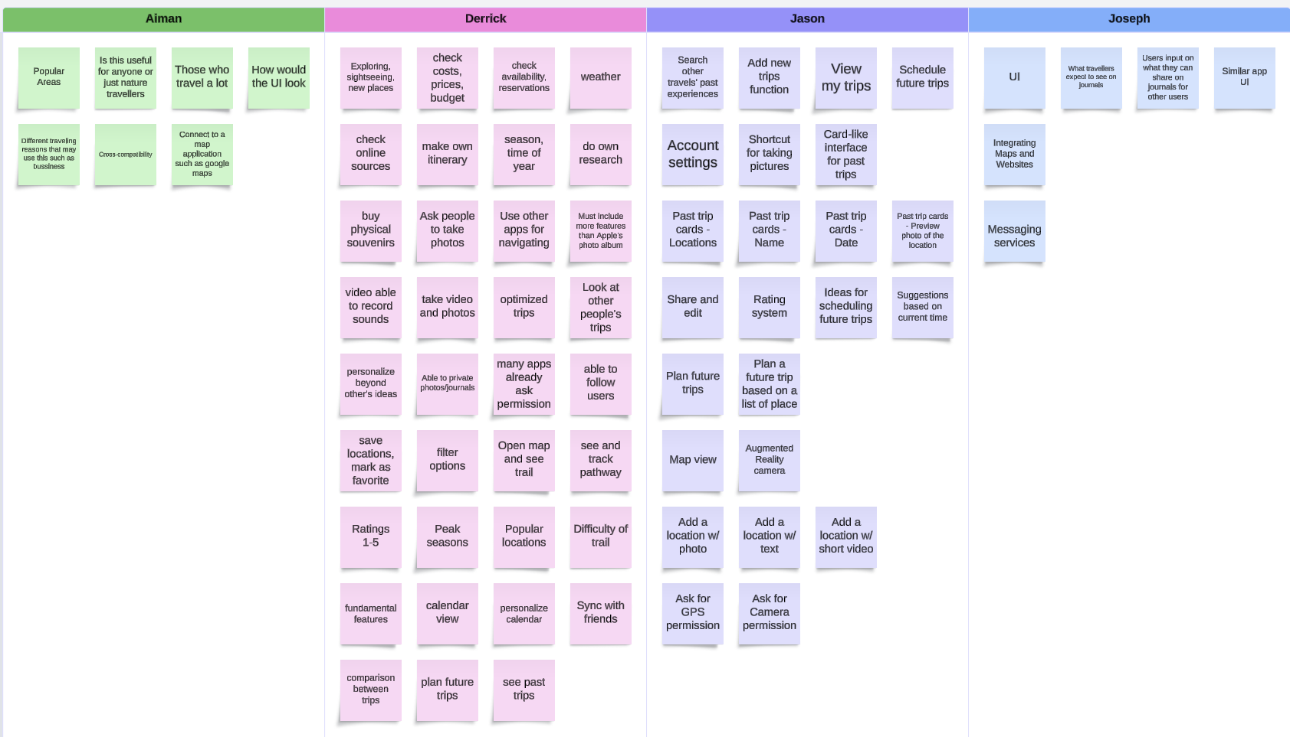

Slide 5
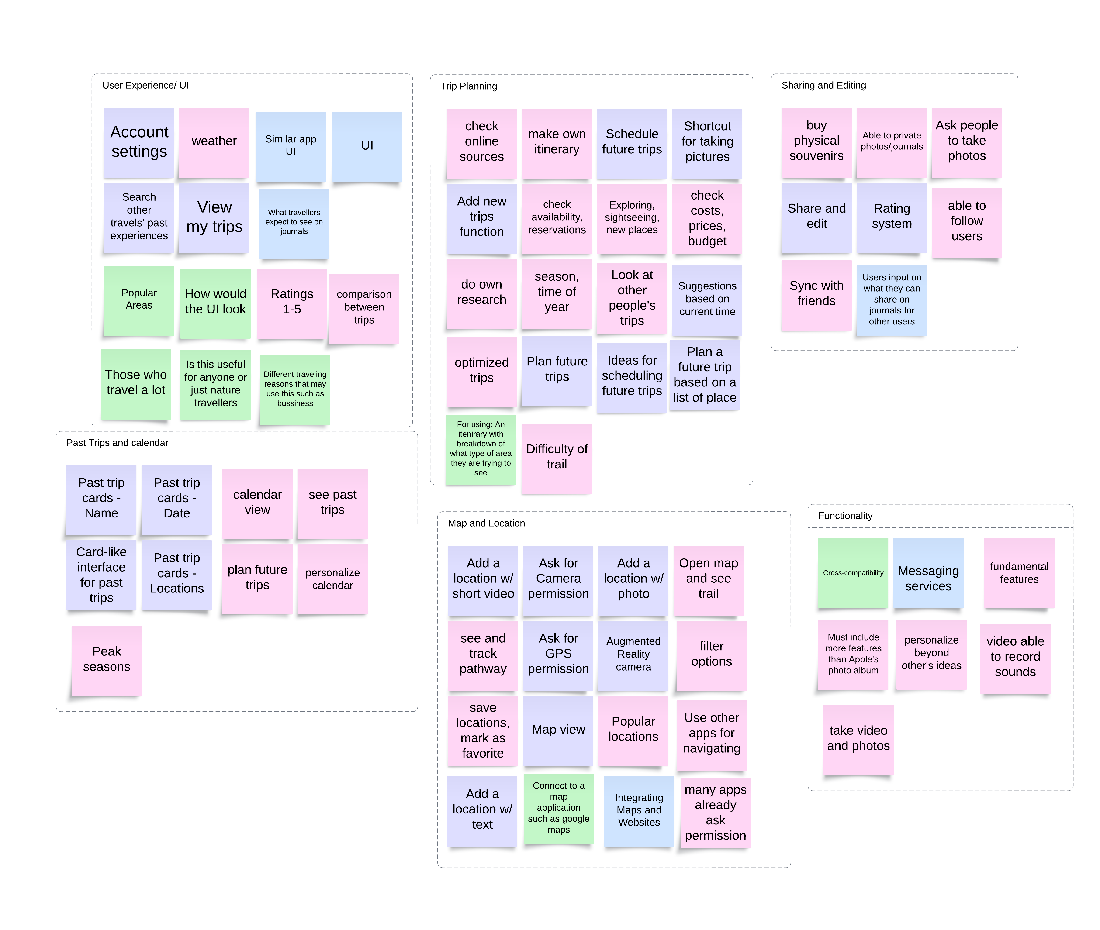

Slide 6
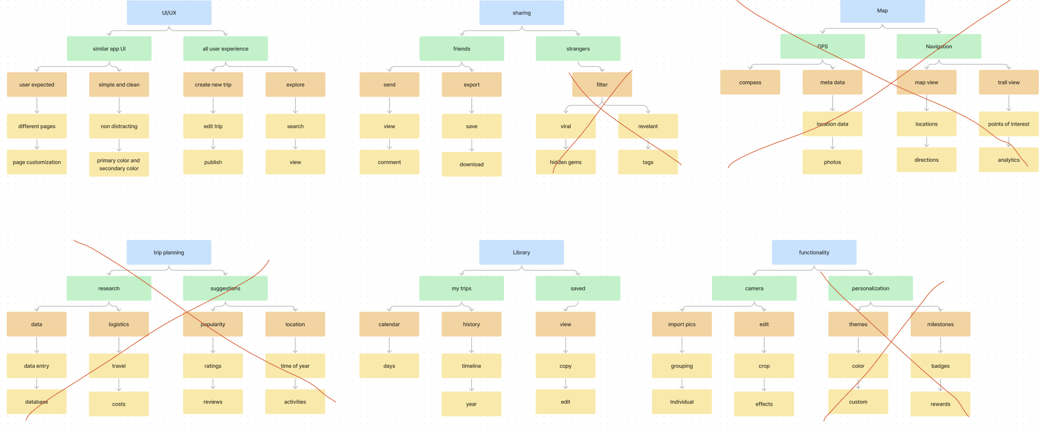

Slide 7
Feedback from pitch presentation.
Try to focus on user needs and implement features that can be delivered by the due date.

Slide 8

Describe any challenges you’re facing
FEEDBACK
We want your responses!
More testing!

Slide 9

Expected vs Actual
Feature | Keep | Axe
Import pic
Trip builder
Saved
Maps
GPS
other
On track with our expectations
Focus on trying to do more user testing along with future developments

Slide 10
Thank you

Slide 11
One more thing...
https://prezi.com/view/q0tRiADdhYaCxiBCiD9v/

